Slide 1
PMIC_BinCheck_Request
20211217
Teradyne Confidential

Slide 2
How to use
Step 1. Please prepare your program. Step 2. Execute Bin check tool with IGXL environment. Step 3. Check Report file.

Slide 3
Check point Review

Slide 4

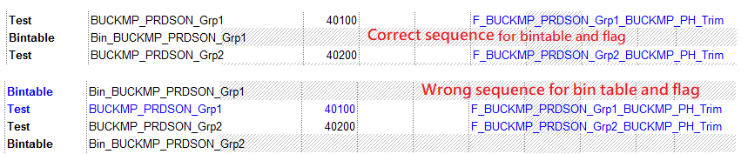
Check point 1
1
2
3
Each sub flow
Bin table sheet
Each sub flow
Step1 : Find the “Bintable” opcode in subflow, get the parameter name for this bintable
Step2: Search the Bin table sheet to get the control flag name setting for Bin table name
Step3: Search the control flag name in subflow, check is it define in same subflow. Also the Bintable sequence need to be correct.

Slide 5
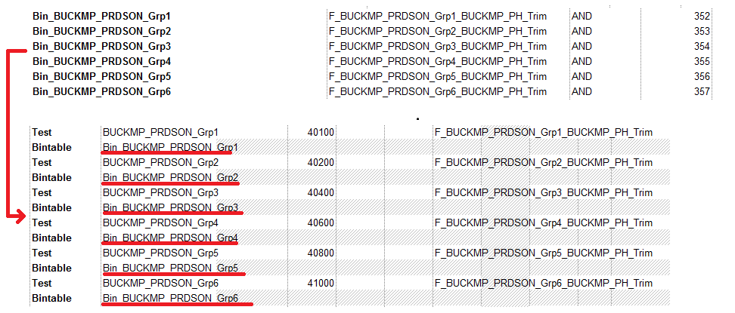
Check point 2
1
2
Bin table sheet
Each sub flow
Step1 : Find the bin name in bintable.
Step2: Search the Bin name in all of flow sheets. Check is it called by any sub flow sheet?
Also need to check SW bin number in “Bin table sheet”. Is any duplicate?

Slide 6
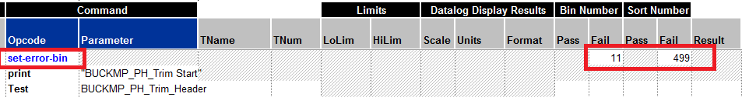
Check point 3
1
2
Each flow
Bin table sheet
Step1 : Find the “set-error-bin” opcode in each flow, get the error bin number.
Need to list the flow which without the error bin setting.
Step2: Search Bin table sheet to get the match SW/HW bin number.
If match need to list which subflow using this error bin.
If no match in bintable, need to report it.

Slide 7
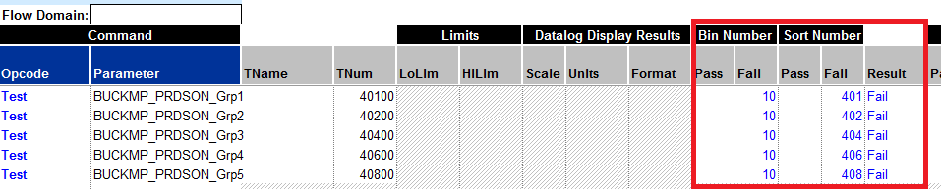
Check point 4
1
2
Each flow
All VBT code
Step1 : Check all flow sheet about the sort bin, hard bin and result have set.
List all of items which have set. (For this case, the test item do not need to set bin table)
Step2: Check VBT code about(next phase)
TheExec.sites.Item(Site).TestResult =siteFail
TheExec.sites.Item(Site).SortNumber = ??
TheExec.sites.Item(Site).BinNumber = ?

Slide 8
New Feature of Check Point

Slide 9
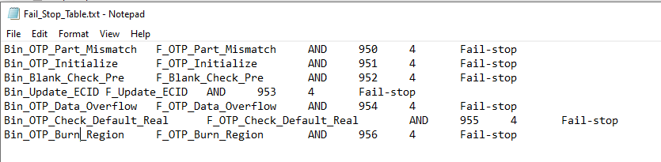
Check point 5-Standard Bin Check
1
2
Config file
Bin table sheet
Step1 : User can list the standard bins to Config file by Project.
file path:(.\Config\Fail_Stop_Table.txt).
Step2:
Standard Bin Check rule is based on soft bin number as the basis for comparison.
All of the soft bin which define in config file need exist in program.

Slide 10
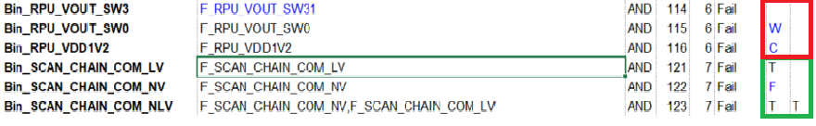
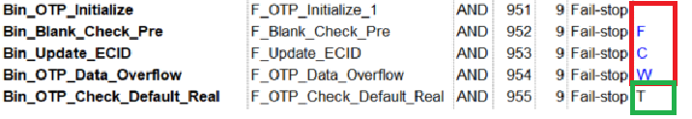
Check point 6-Fail Flag Symbol Check
1
2
Bin table sheet
All Bin Flag Check
Step1 : Check the value of all Flag Symbol.
Flag of Normal Bin: only F or T (Red Frame will show fail.)
Flag of Standard Bin: Only T (Red Frame will show fail.)

Slide 11
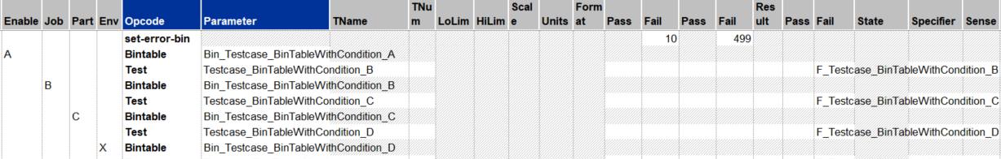
Check point 7-No Bin Out Check
1
2
3
Each sub flow
Bin table sheet
Each sub flow
Step1 : Check the Flag of test item exist or not.
If bin flag is empty, report Item NoBinOut.
If the flag exists, check any relative bin name use same flag. If not, report Item NoBinOut.
If the bin name not exist in same flow, list Item in the report.
Step2 : Check any gating rule of Opcode “BinTable”.
If there is any rule in the BinTable, list Item in the report.
Flag is empty
BinTable with condition

Slide 12
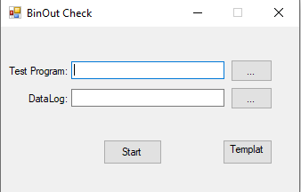
Check point 8-No Bin Out Check Reference Datalog
1
2
3
Each sub flow
Bin table sheet
Each sub flow
Step1 : Offer a datalog that log from test program.
Step2 : Check Method is as same as Check Point7 and list Item in the report(NoBinOut ReferenceDatalog).
Insert the program you want to check
Insert the datalog you want to check

Slide 13
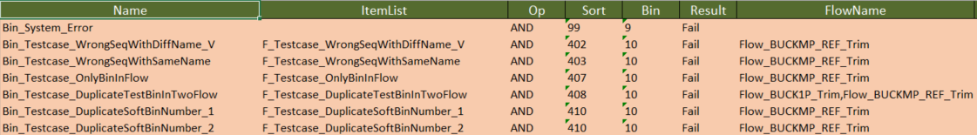
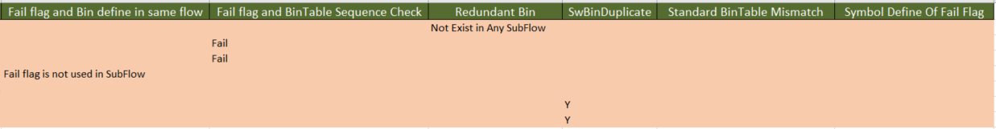
Output report-BinOut Sheet
Bin Name
Flag Name
SubFlow
Check Point

Slide 14
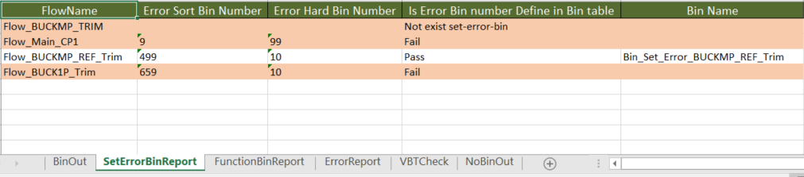
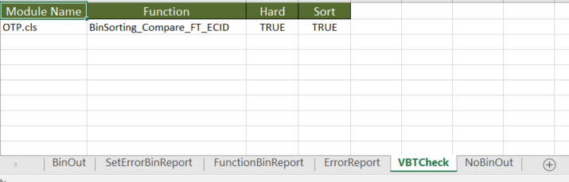
Output report
To check each sub flow the error bin setting
Check Point: Is any function setting the Bin number in flow sheet?
Check Point: Is any function setting the Bin number in VBT code?

Slide 15
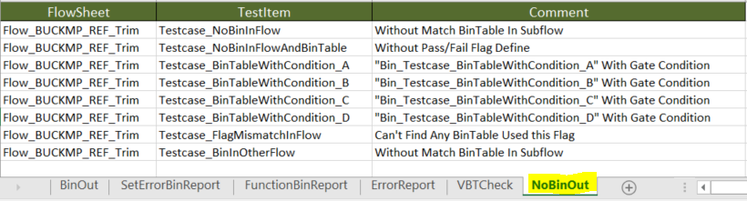
Output report-NoBinOut Sheet
This sheet will list NoBinOut check result and show the reason in Comment Column.

Slide 16
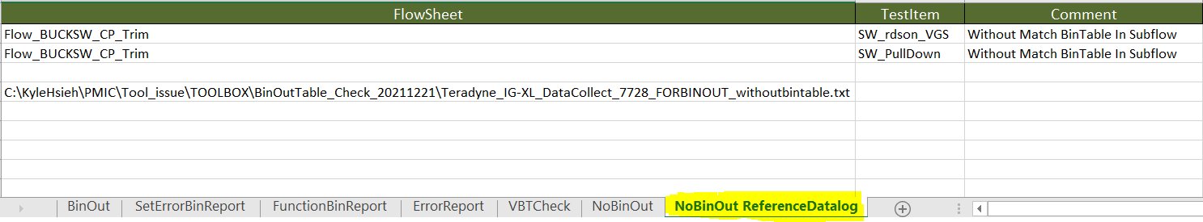
Output report-NoBinOut Sheet
This sheet will list NoBinOut-ReferenceDatalog check result and show the reason in Comment Column.

Slide 17
END
Notes:
Add a summary page of improvements

